Slide 1
Traffic Forecasting using CRN with LSTM and GRU Neural Networks
STUDENT NAME | STUDENT ID
Shashank Gautam | 2020B5A32378H
Viraj Mathur | 2020B4A30956H
Udit Gupta | 2020B4A72368H

Slide 2

Brief Introduction
Traffic congestion is a common and frustrating issue in urban areas.
To address congestion between junctions, we can improve infrastructure, but it's essential to conduct a thorough traffic flow analysis at each junction first.
One effective approach to tackle this challenge is to treat the traffic congestion on individual junction as separate time-series data.
By analyzing historical data and using it to predict future congestion levels for each junction, we can work towards a solution.

Slide 3
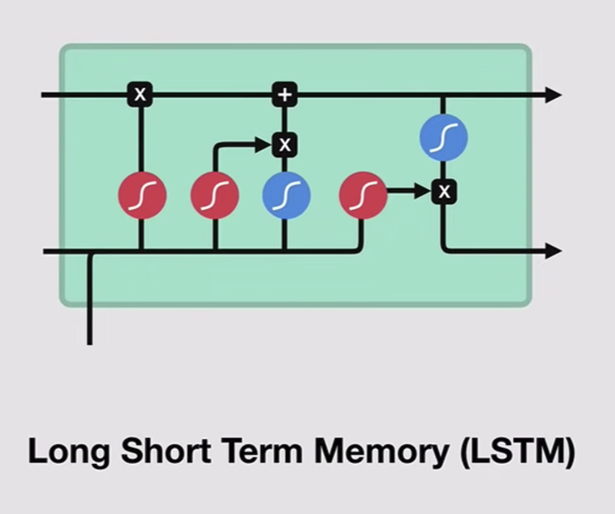
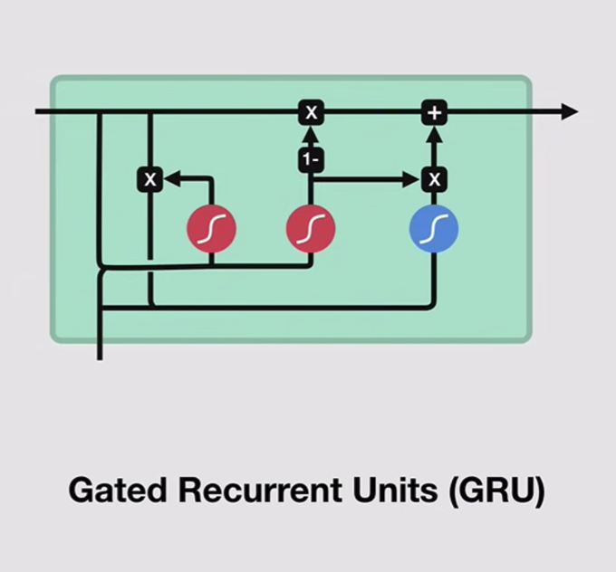
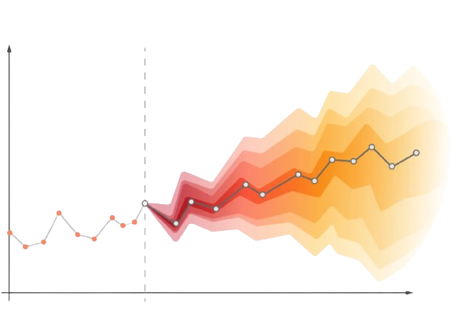
Objectives
1. Propose a new model for Traffic Forecasting using GRU on short term data and then using it for prediction on multiple junctions.
2. Generate a GRU-LSTM Hybrid model and comparing its performance with other implementations like ARIMA.
3. Running the model on a real-world dataset (from 11 junctions in the city of London).
Autoregressive Integrated Moving Average (ARIMA)

Slide 4
Pre Mid-Sem

Slide 5
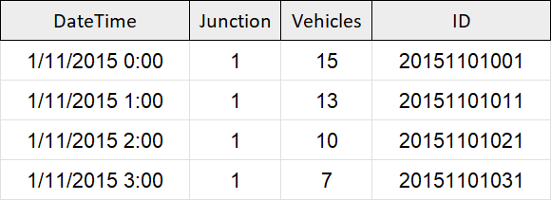
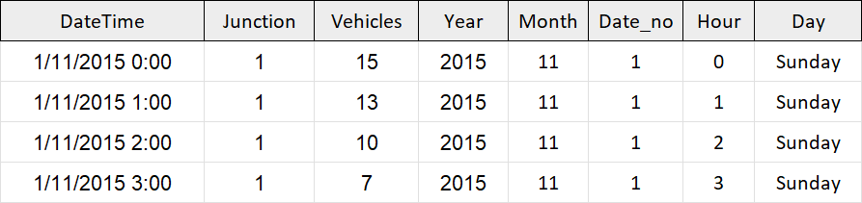
Methodology and Mathematical Formulation Pre Mid-Sem
The dataset chosen was a collection of numbers of vehicles at four junctions (48,120 entries) at an hourly frequency. The CSV file provides the four features:
DateTime
Junctions
Vehicles
ID
Sensors collected data at different times, resulting in varied time periods. Some junctions had sparse data.
The ID feature was dropped and DateTime is extended to give additional features:
Year
Month
Date in the given month
Day of the week
Hour

Slide 6
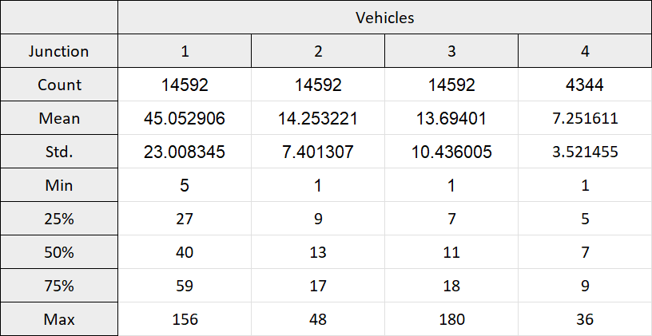
Methodology and Mathematical Formulation Pre Mid-Sem (contd.)
The feature-rich dataset obtained was then transformed (through normalization and differencing) and preprocessed through the following steps:
Creating different frames for each junction
Transforming the series
Performing the Augmented Dickey-Fuller Test to check the seasonality of the transformed series
Creating test and train sets (10% and 90%)
A GRU model was then built on the obtained test and train sets which is followed by model-fitting.
Finally, the plots are inverse transformed to make accurate-scaled predictions.
Different junction frames

Slide 7
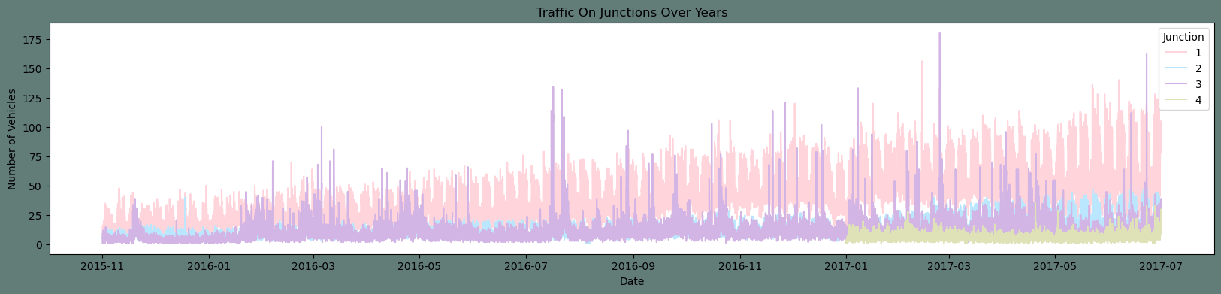
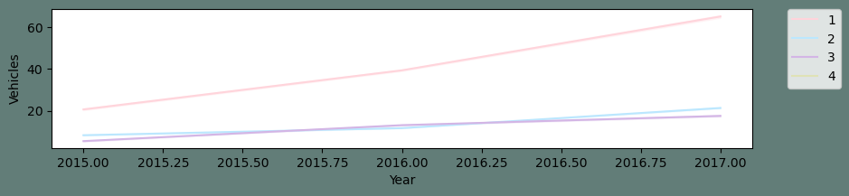
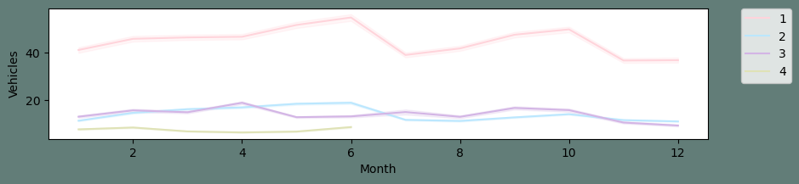
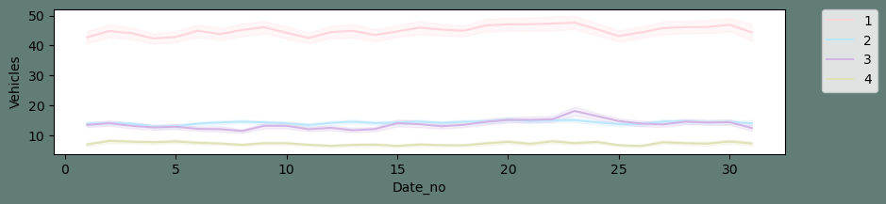
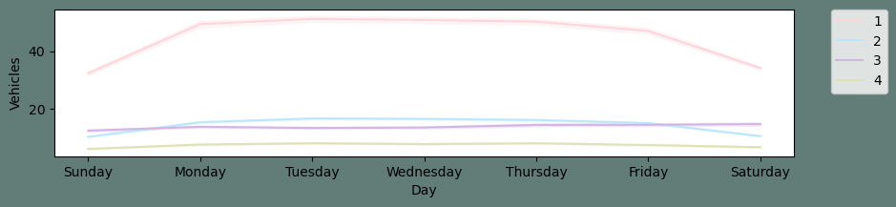
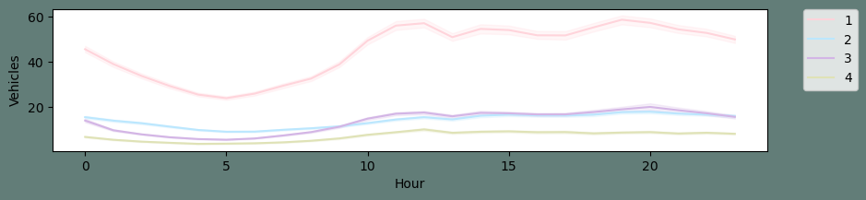
Work Done Till Mid-Sem [Results]
Firstly, the entire dataset without the additional features was plotted:
It can be seen that:
The first junction is visibly having an upward trend.
The data for the fourth junction is sparse starting only after 2017.
Seasonality is not evident from the above plot.
Next, the features added to DateTime were plotted individually:

Slide 8
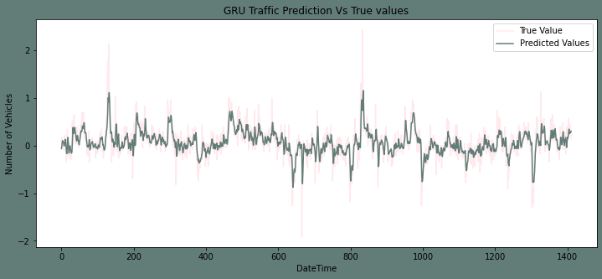
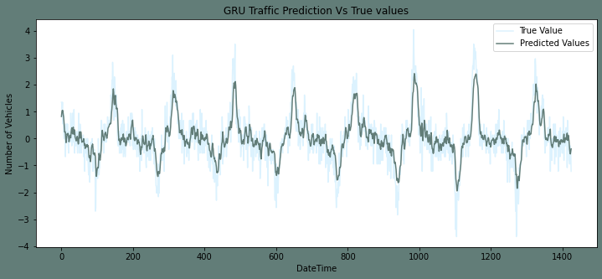
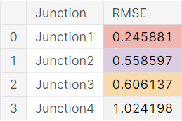
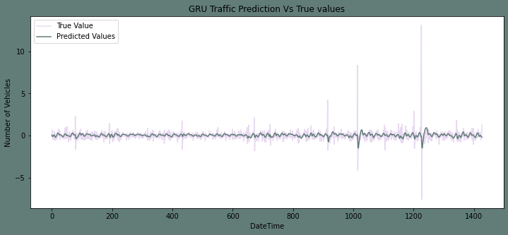
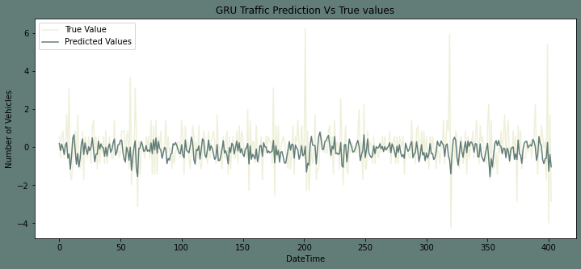
Work Done Till Mid-Sem [Results] (contd.)
Now, a GRU model was created and the transformed training sets of the four junctions were fitted to the model. They were then compared to the transformed test sets. The plots (along with RMSEs) for all the fitted junctions are as follows:
The plots were then inverse transformed to make accurate-scaled predictions.
Junction 1
Junction 2
Root Mean Squared Error of all the four junctions
Junction 3
Junction 4

Slide 9
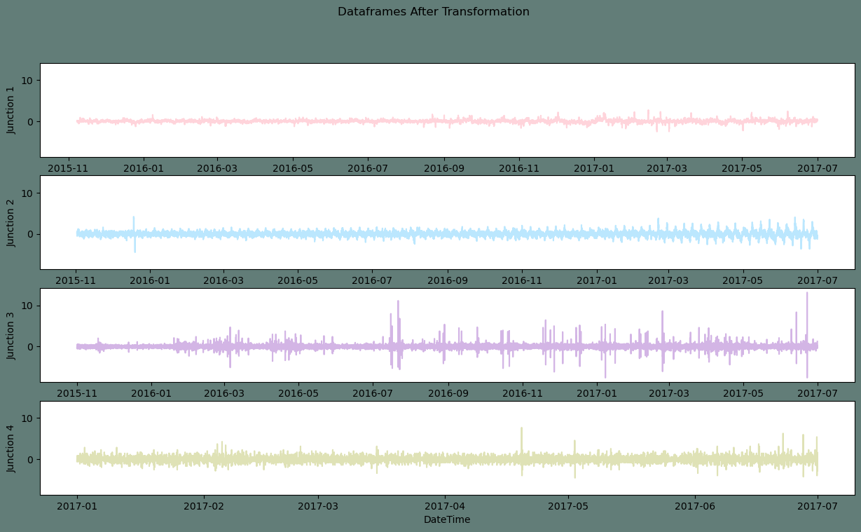
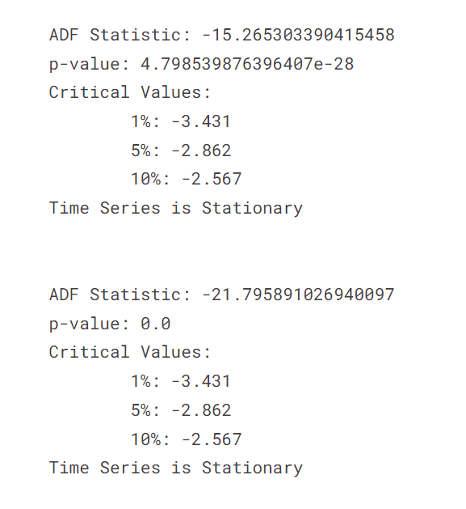
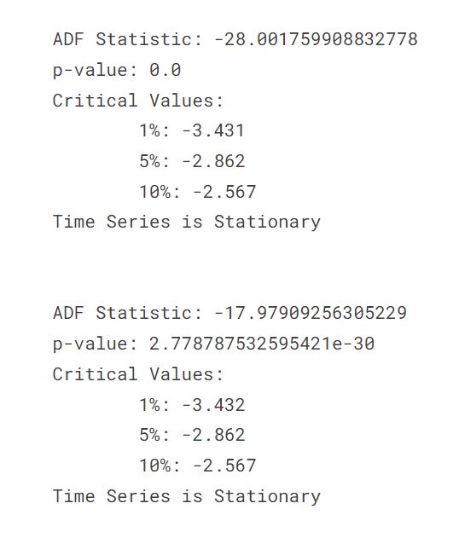
Work Done Till Mid-Sem [Results] (contd.)
The data was then fed for normalization and differencing.
To ensure the stationary nature of the plots, Augmented Dickey-Fuller Test was performed.
The results are as follows:
Result of Augmented Dickey-Fuller Test
Dataframes after Transformation (normalization + differencing)

Slide 10
Post Mid-Sem

Slide 11
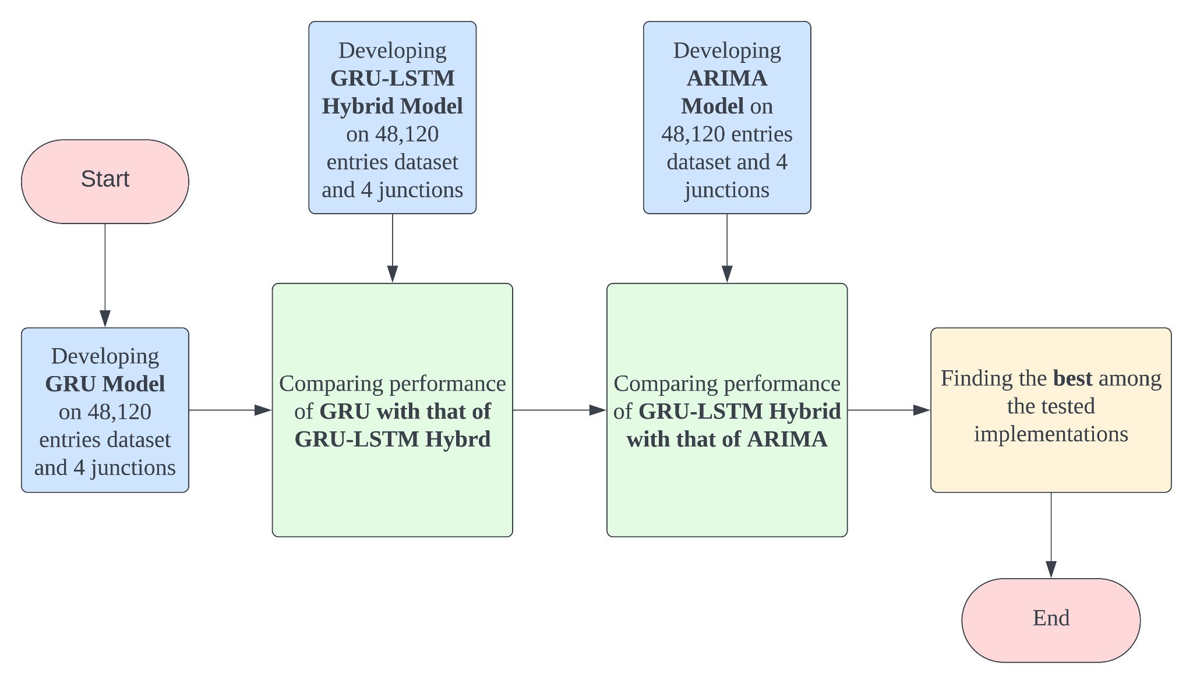
Flow-Chart of the Entire Project

Slide 12
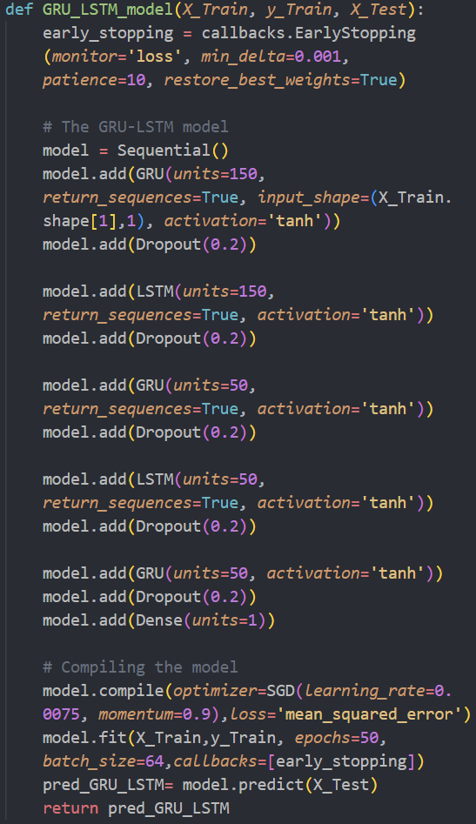
Methodology and Mathematical Formulation Post Mid-Sem
A GRU-LSTM hybrid model was now formulated on the dataset used earlier (with 48,120 entries). The following steps were followed in defining the model:
Early stopping was implemented to stop training if the loss doesn't decrease by 0.001 for 10 consecutive epochs.
The sequential model combines GRU and LSTM layers, starting with GRU, adding dropout (to avoid over-fitting), and following a similar pattern with LSTM layers.
The model concludes with a GRU layer without return sequences and a dense layer for regression tasks.
Finally, the model was compiled using SGD compiler with 0.0075 learning rate.

Slide 13
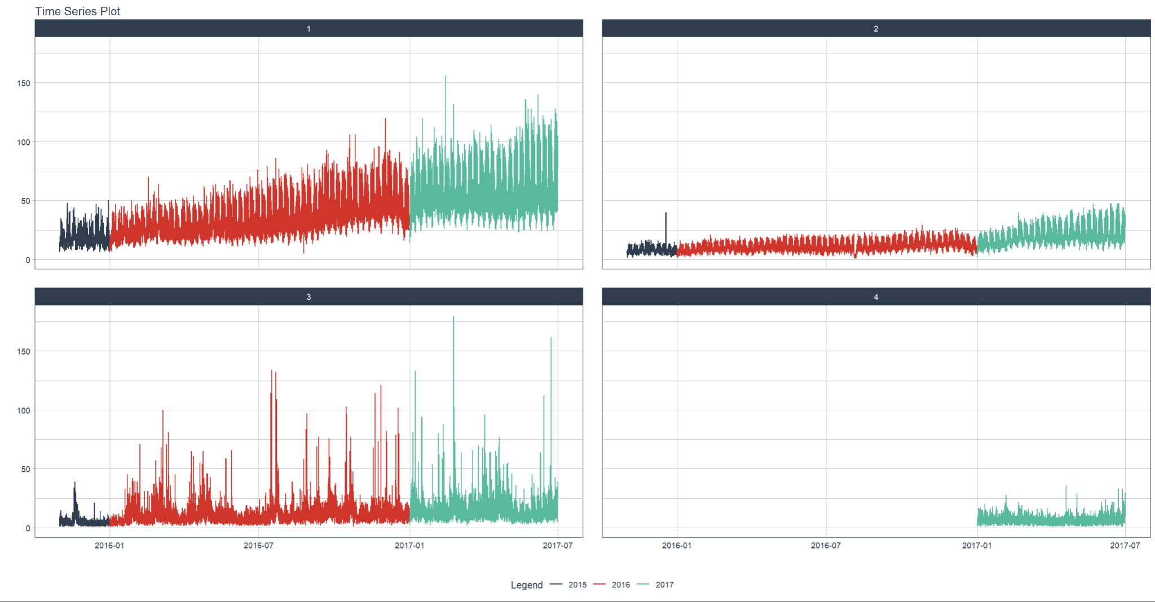
Methodology and Mathematical Formulation Post Mid-Sem (contd.)
After the successful completion of GRU-LSTM Hybrid model, a new ARIMA based model is then implemented in R.
This model was implemented on the same dataset (with 48,120 entries) so that its performance could be compared with that of the previous model(s).
We begun by plotting the entire dataset for familiarity (for all 4 junctions):

Slide 14
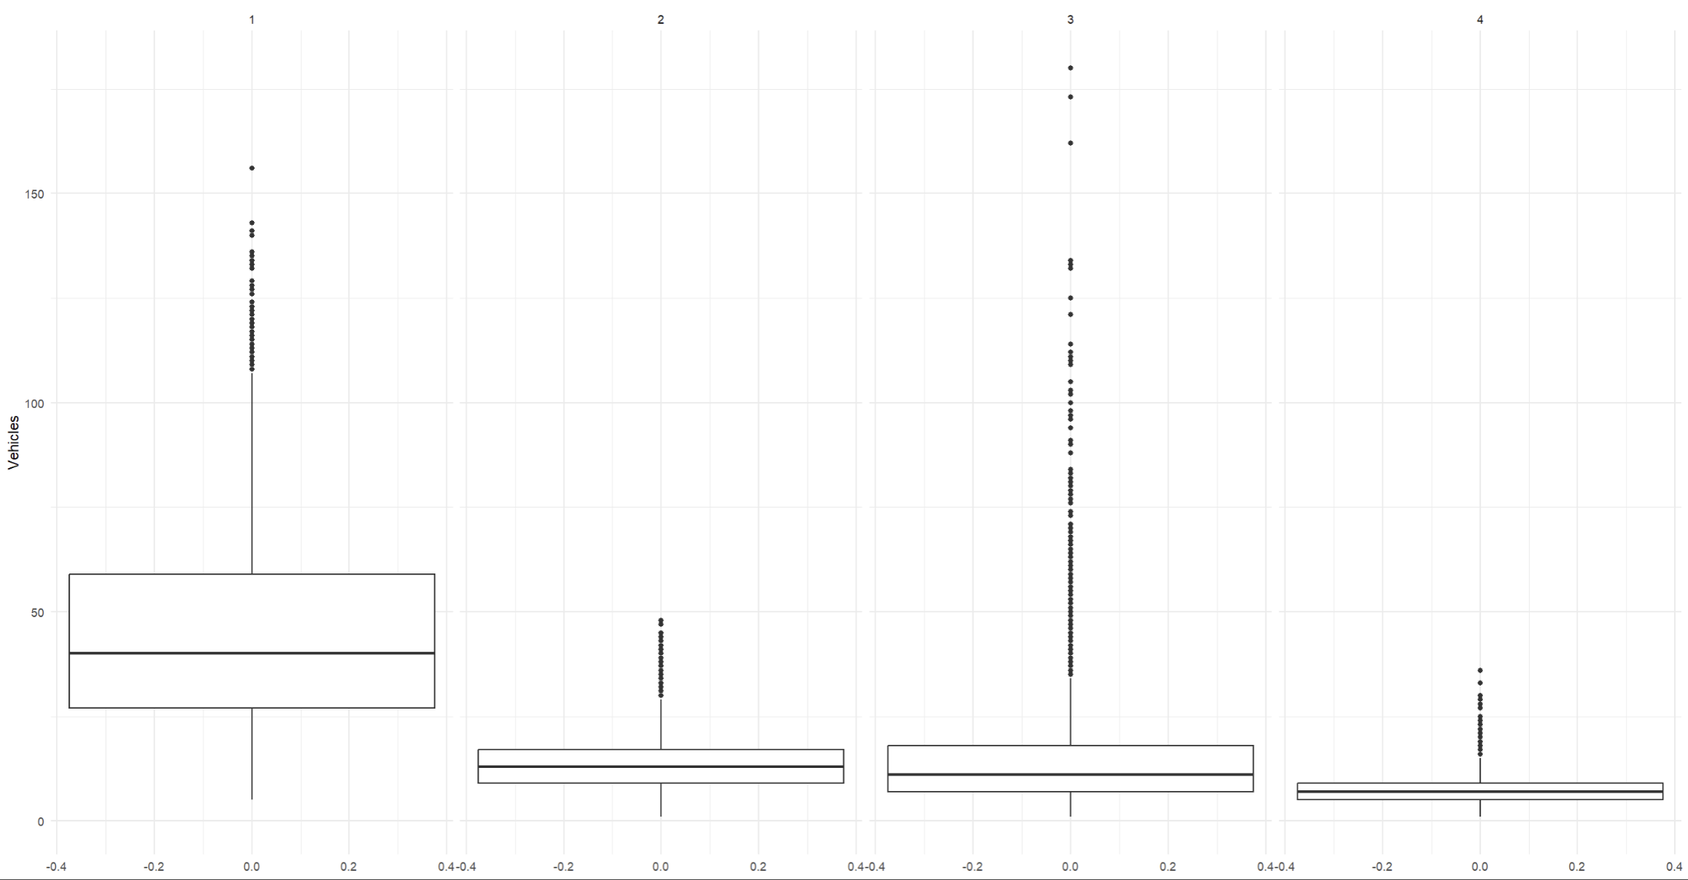
Methodology and Mathematical Formulation Post Mid-Sem (contd.)
The dataset was now explored even further which is evident through the following plots:
Box-Plot of all junctions:
From the above plot, it is evident that:
Data in Junction 1 tends to spread out and has the highest mean.
Data in Junction 2 and 4 tends to spread in.
Junction 3 has the most outlier.

Slide 15
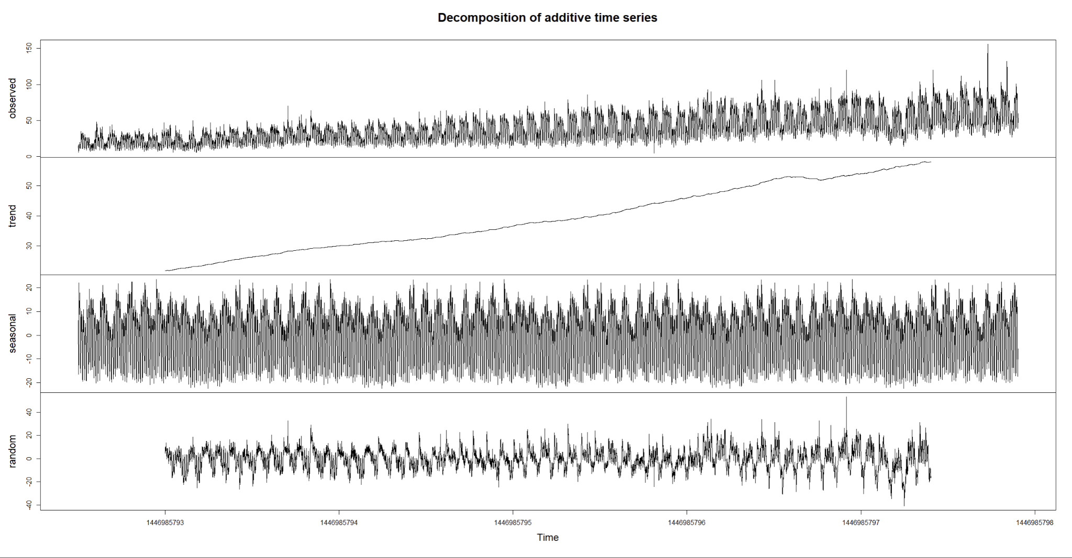
Methodology and Mathematical Formulation Post Mid-Sem (contd.)
Plot obtained through Additive Decomposition:
From the plot, we can’t find any seasonality.
But the observed data might be not stationary, hence ADF and KPSS tests were conducted before creating ARIMA model.

Slide 16
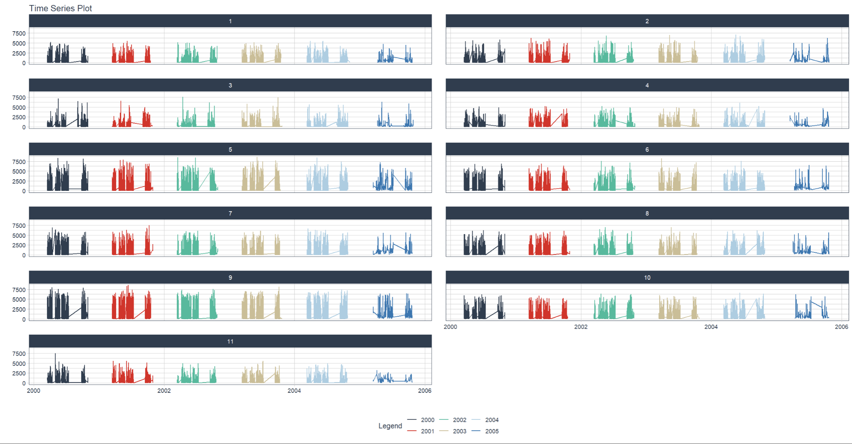
Methodology and Mathematical Formulation Post Mid-Sem (contd.)
Finally, after some data adjustments, the ARIMA model was built and different ARIMA(p, d, q) models were tested and compared, where:
p: Number of autoregressive (AR) terms.
d: Number of order of differencing.
q: Number of moving average (MA) terms.
At the end, a real-world dataset was taken up with 10,48,575 entries consisting of traffic flow data of 11 popular junctions in the city of London (from the year 2000 to 2005).
At the right is the entire plotted dataset.
From the plot, it is evident that there are periods where the data is not available (unobtained).

Slide 17
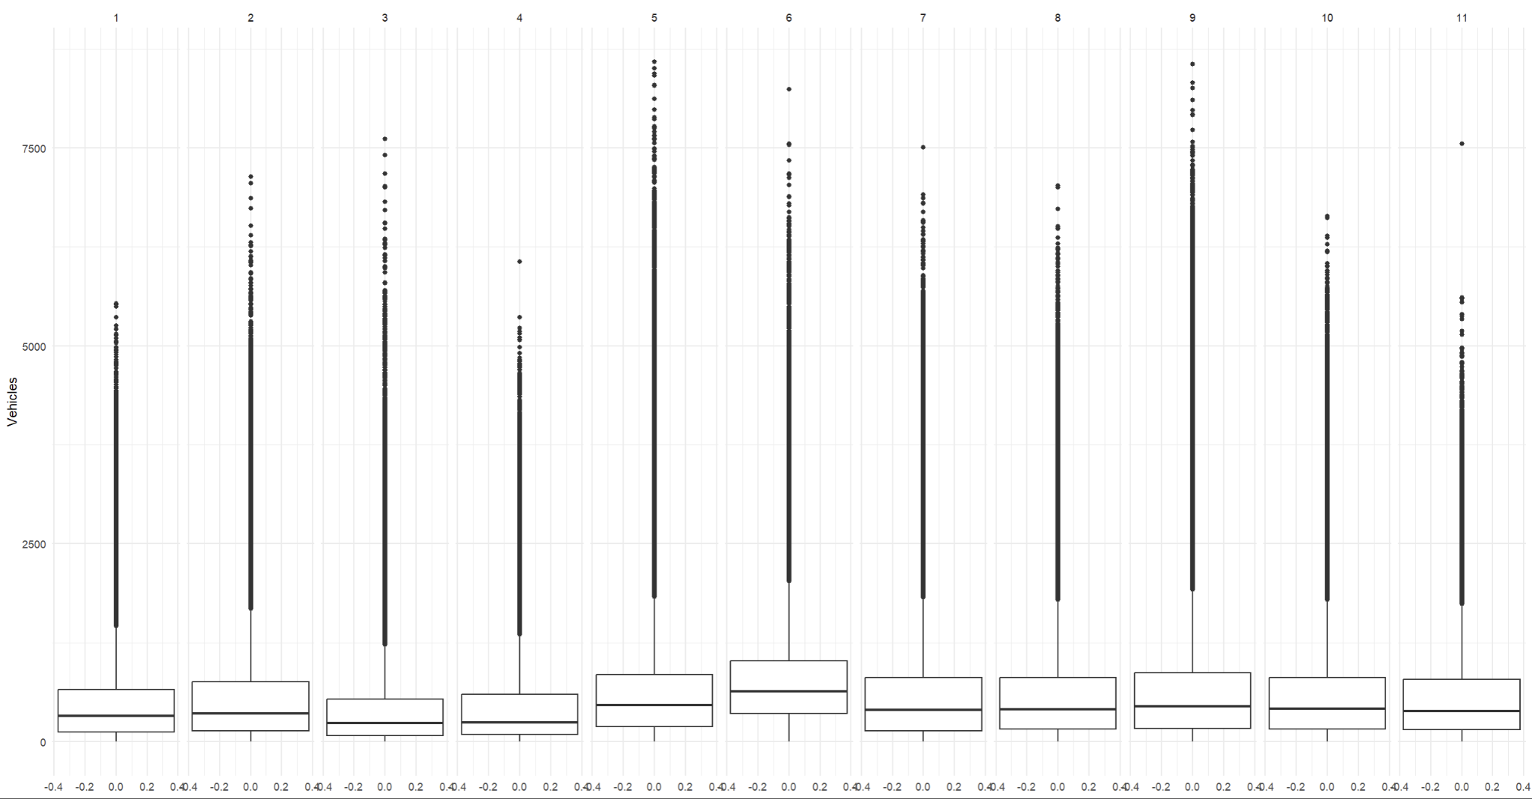
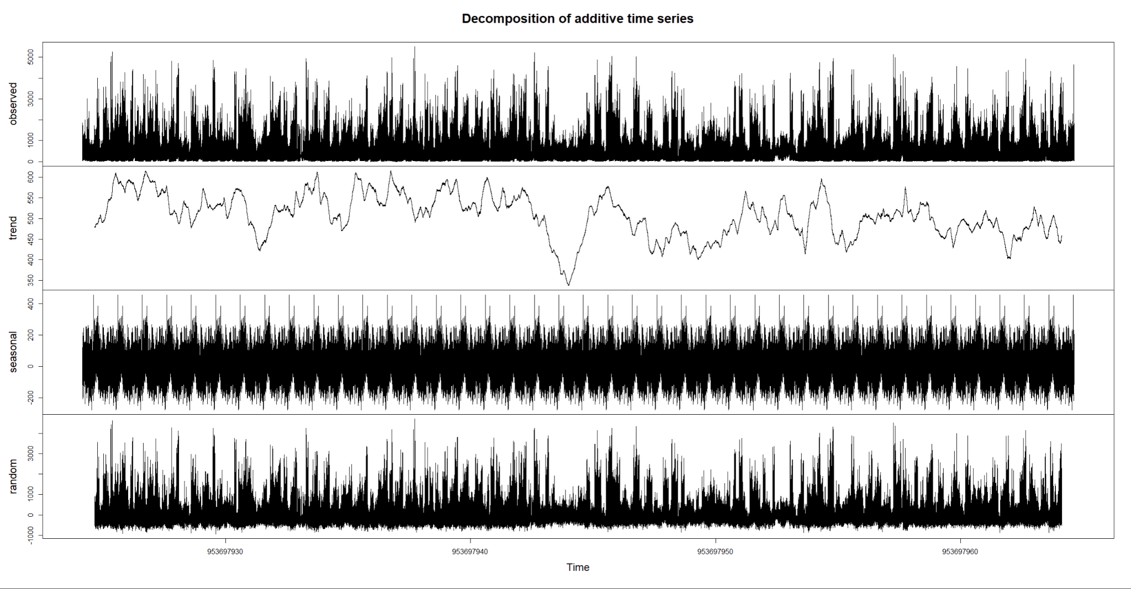
Methodology and Mathematical Formulation Post Mid-Sem (contd.)
Box-Plot and Additive Decomposition were plotted as usual:
From the two plots, it can be seen that:
Junction 5 has the highest mean, but traffic at all junctions is somewhat equally spread out showing how even the traffic is in London.
Seasonality could not be found from the additive decomposition plot hence, ADF and KPSS tests were remained to be carried out.
Again, ARIMA models were built & compared after some data manipulation.
Box Plot
Additive Decomposition Plot

Slide 18
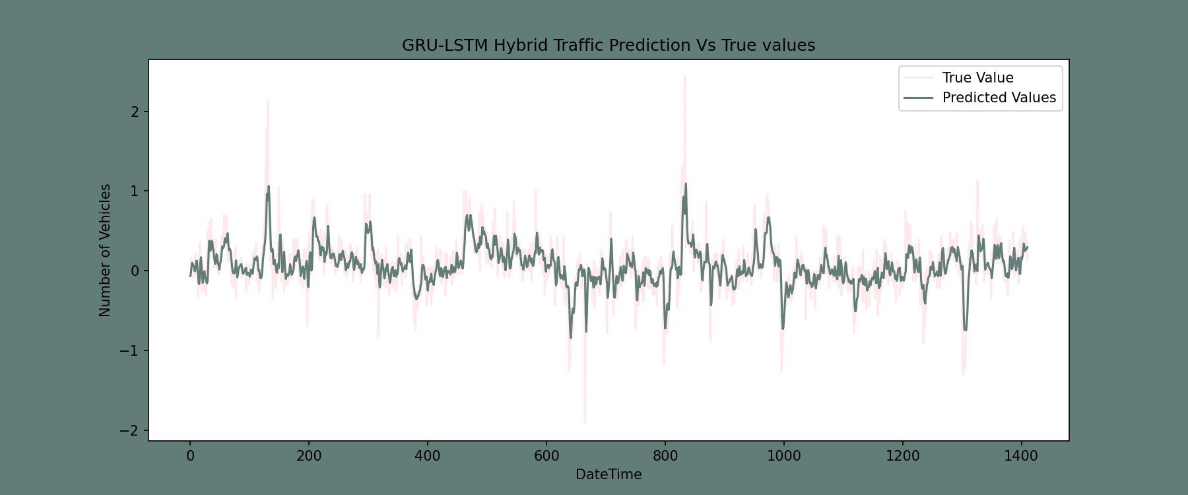
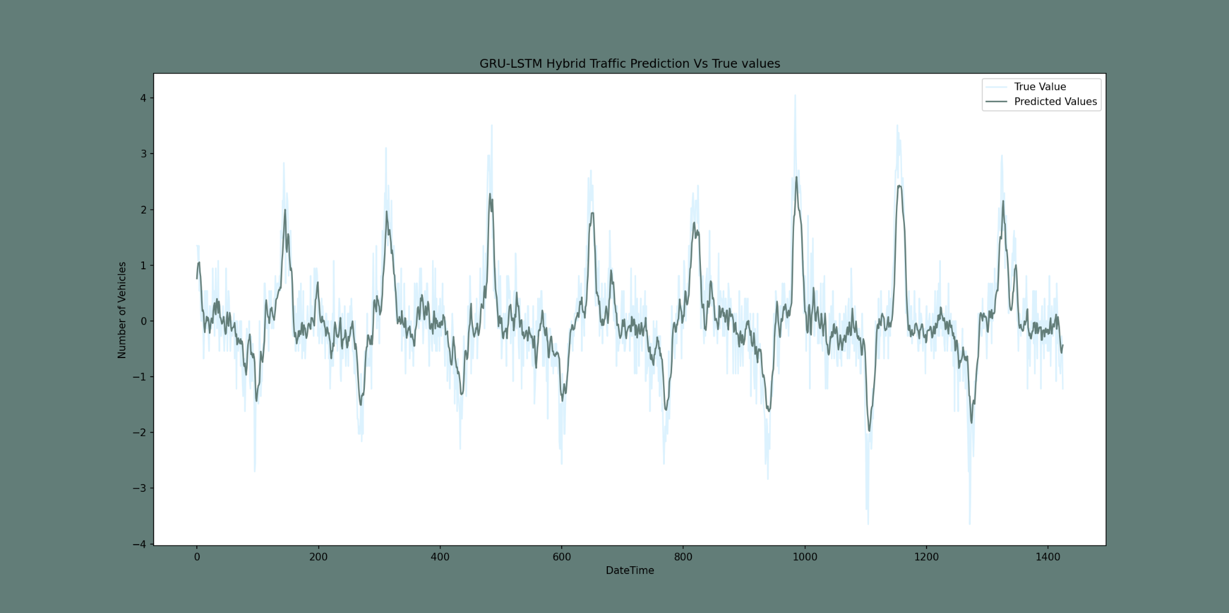
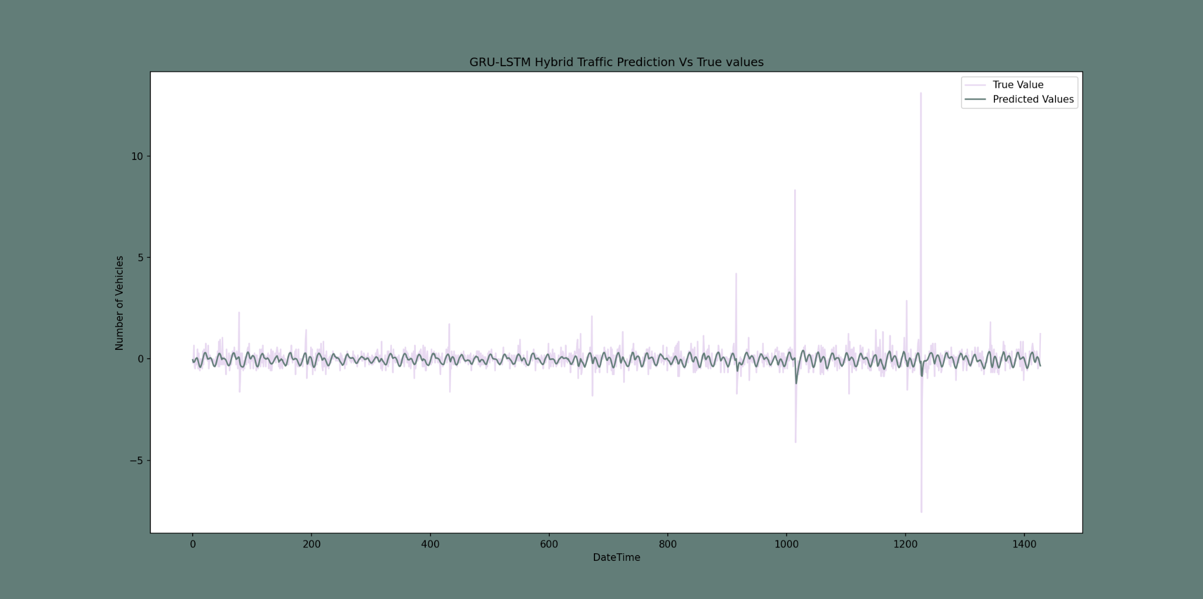
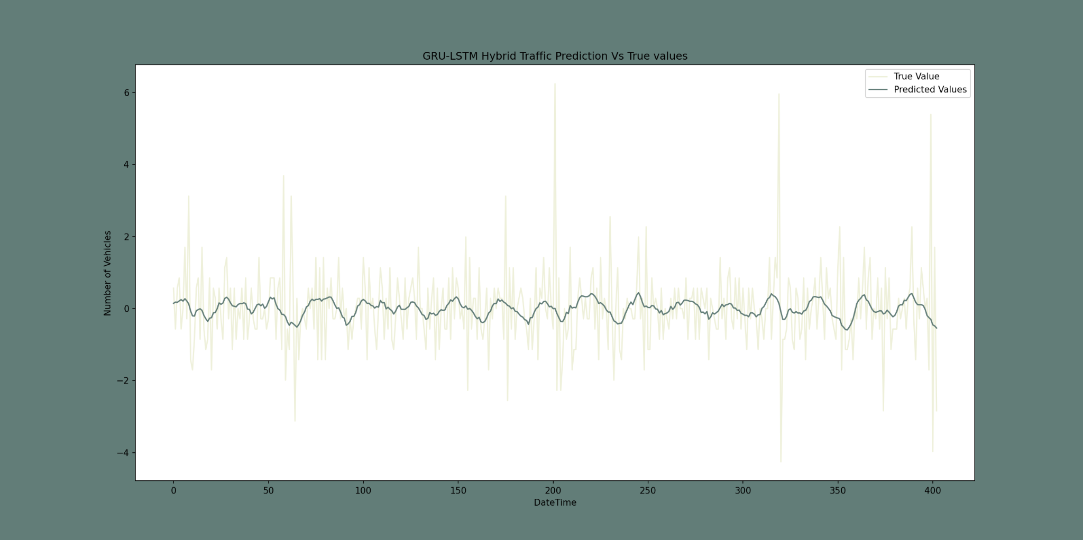
Results Post Mid-Sem
For the GRU-LSTM Hybrid model (on the 48,120 entries dataset), the following prediction model plots were obtained:
Junction 1
Junction 2
Junction 3
Junction 4

Slide 19
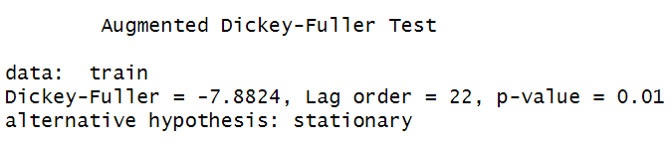
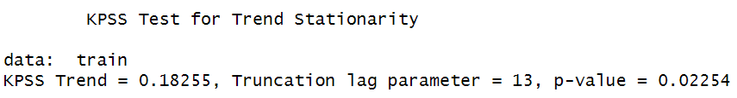
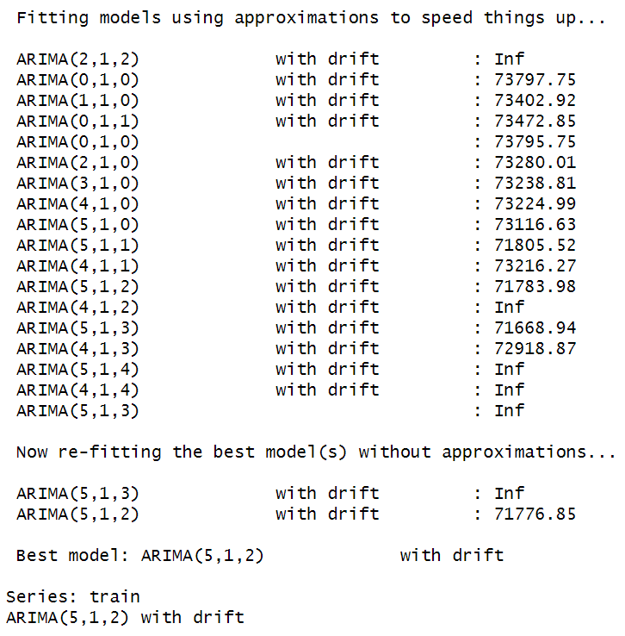
Results Post Mid-Sem (contd.)
Coming to the ARIMA model (on the 48,120 entries dataset), firstly, following were the results of the ADF and KPSS tests:
After these tests, followed data manipulation and model fitting for different ARIMA(p, d, q) models which were as follows:
ARIMA(5, 1, 2) performed the best

Slide 20
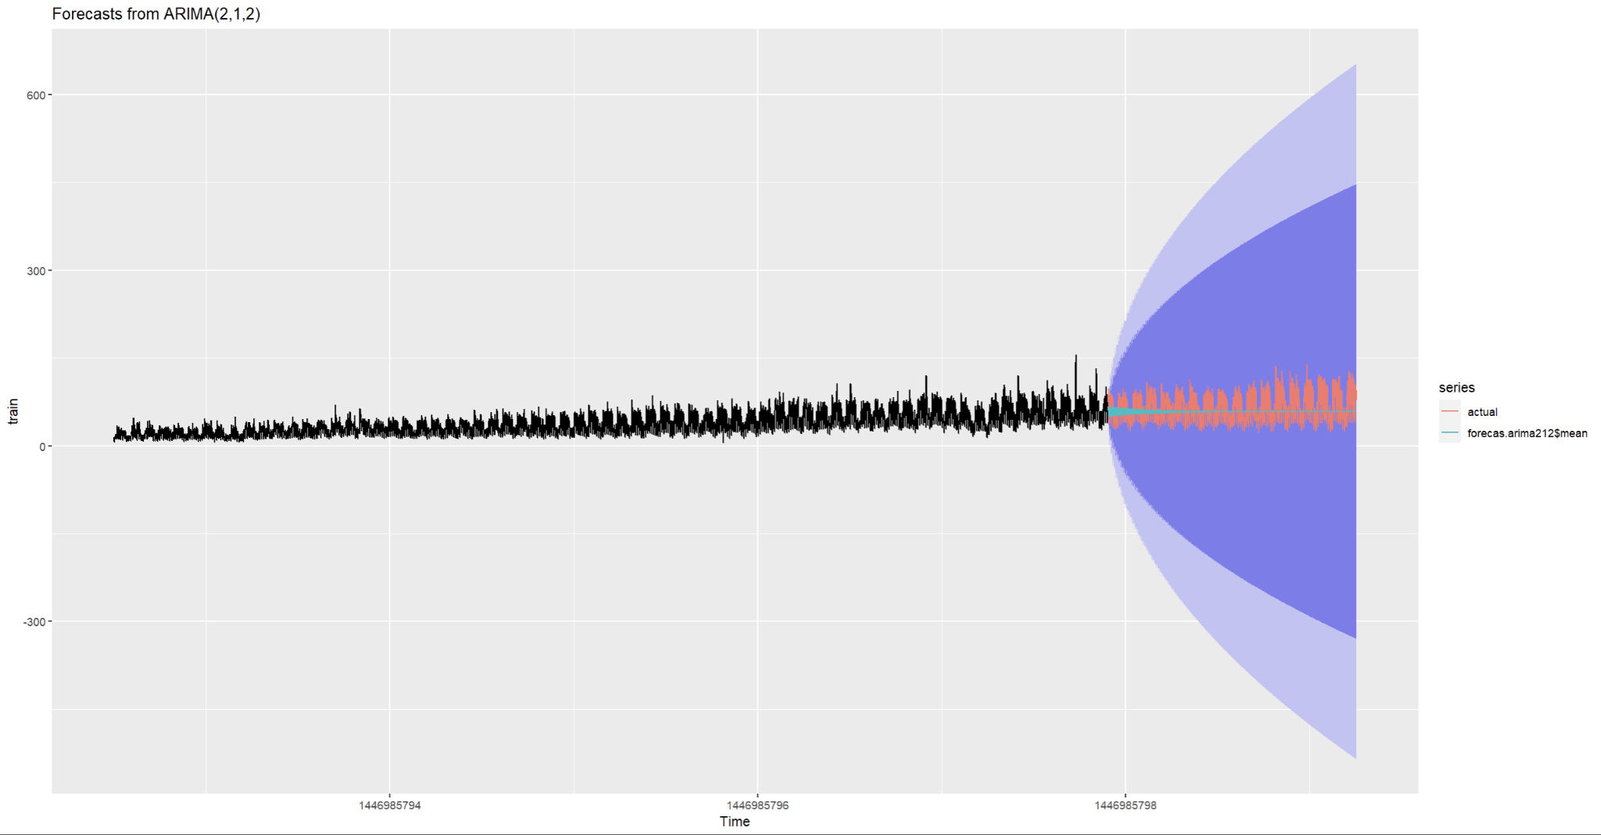
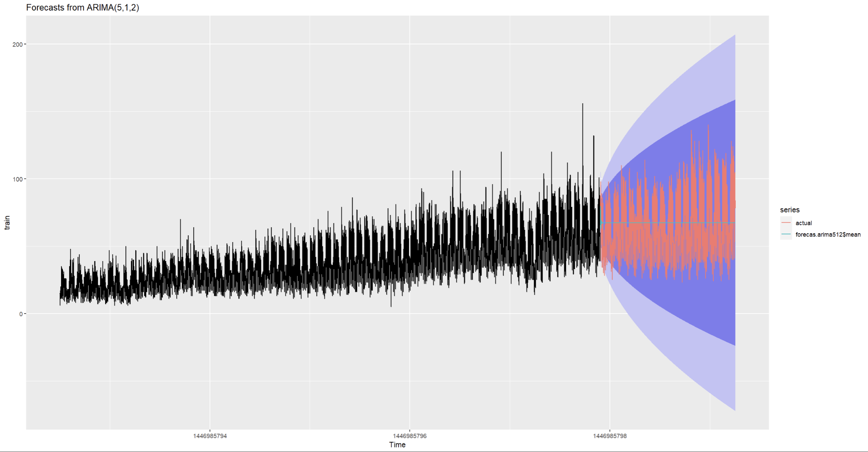
Results Post Mid-Sem (contd.)
Forecasts of ARIMA(2, 1, 2) and the best ARIMA(p, d, q) model obtained earlier were plotted:
Forecasts of ARIMA(2, 1, 2)
Forecasts of ARIMA(5, 1, 2)
Better!

Slide 21
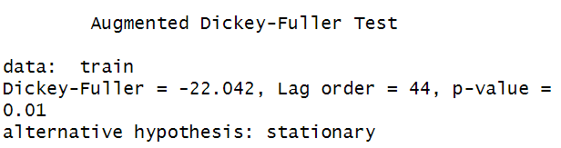
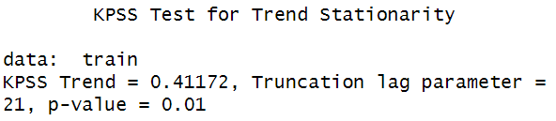
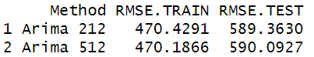
Results Post Mid-Sem (contd.)
We deduced that the ARIMA Model performed better than GRU-LSTM Hybrid Model (covered in Conclusion) and hence the London Junctions dataset with 10L+ entries was fed to ARIMA. The ADF and KPSS results were as follows:
In this case, ARIMA(2, 1, 2) performed the best as is evident from the RMSEs obtained below:
RMSE of ARIMA(2, 1, 2) < RMSE of ARIMA(5, 1, 2)

Slide 22
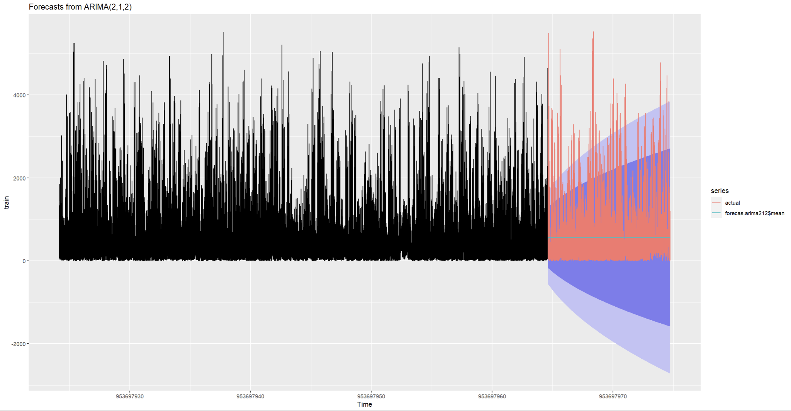

Results Post Mid-Sem (contd.)
Forecasts of ARIMA(2, 1, 2) and ARIMA(5, 1, 2) models obtained earlier were plotted:
Forecasts of ARIMA(2, 1, 2)
Forecasts of ARIMA(5, 1, 2)
Better!

Slide 23
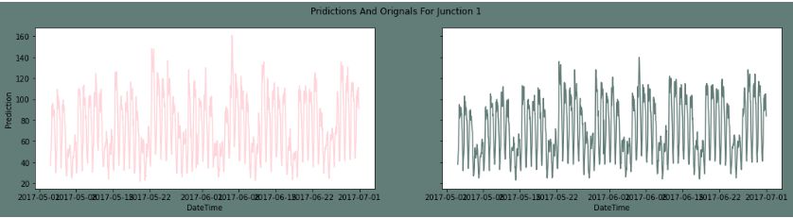
Conclusion
Between GRU and GRU-LSTM Hybrid Models of Traffic Forecasting, GRU-LSTM Hybrid Model was marginally more accurate.
Between GRU-LSTM Hybrid and ARIMA Models of Traffic Forecasting, ARIMA gave much accurate results.
GRU Prediction Plot for Junction 1
GRU-LSTM Prediction Plot for Junction 1
GRU-LSTM (dn) Prediction Plot for Junction 1
ARIMA Prediction Plot for Junction 1

Slide 24
Conclusion (contd.)
Hence among the three tested implementations, ARIMA is best-suited to forecast real-world traffic.
ARIMA(5, 1, 2) performed better than ARIMA(2, 1, 2) when tested on a smaller dataset and vice-versa when tested on a huge real-world dataset.
Hence, a smaller and well organized dataset can perform a lot different than a larger datasets that might have gaps.
Also, ARIMA Model took a lot less time to fit and predict as compared to GRU and GRU-LSTM Hybrid.
Overall, with this comprehensive analysis of traffic conditions using concepts of Neural Networks, we can very efficiently improve traffic conditions if implemented properly before opting for other measures to improve infrastructure.

Slide 25
Learning Outcomes
The GRU-LSTM hybrid performs better than GRU.
ARIMA is more applicable than GRU-LSTM.
Real-Time Data Integration: We can add more features and analysis in ARIMA model as compared to GRU-LSTM Hybrid.
Deployment and Scalability: Investigate deployment of the model in a real-world traffic management system, focusing on scalability and efficiency to handle larger datasets and high traffic volumes.
Data Analysis from the model: Comparing the results with different models such as interpolation, LSTM and ARIMA we can conclude for better study for traffic model development and can study the traffic flow aswell.

Slide 26
Thank you!

